Slide 1
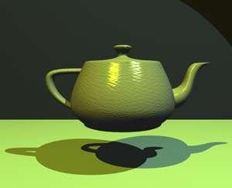

Introduction to Computer Graphics
Image: The Utah Tea pot, Finlay McWaiter
Brac University

Slide 2
Plan
Overview of computer graphics
Administrivia
Overview of the semester
Overview of the assignments
Intro to JOGL & assignment 0

Slide 3
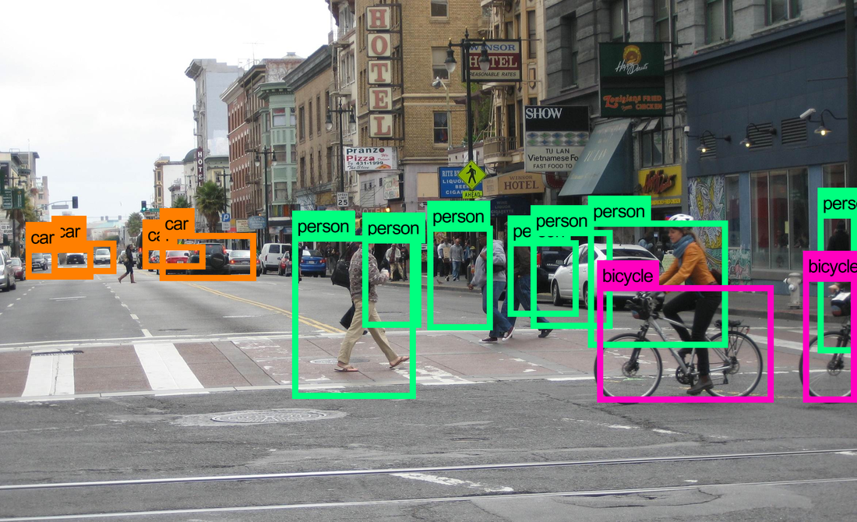

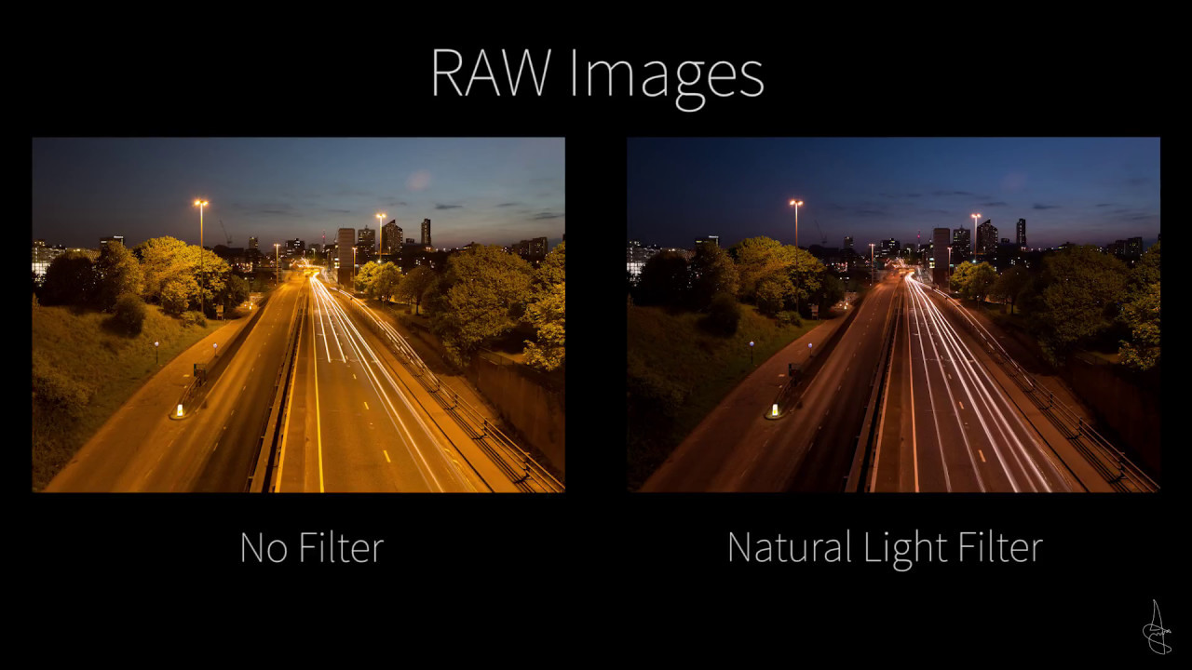
Computer graphics: what does it mean?
Computer vision: extracting information from the contents of an input image or video frame.
Ex: face recognition
Computer graphics: creating an image from scratch using computer.
Ex: animated movie
Digital image processing: processing raw input image to perform different operations.
Ex: apply filter on an image

Slide 4
Applications of Computer Graphics

Slide 5
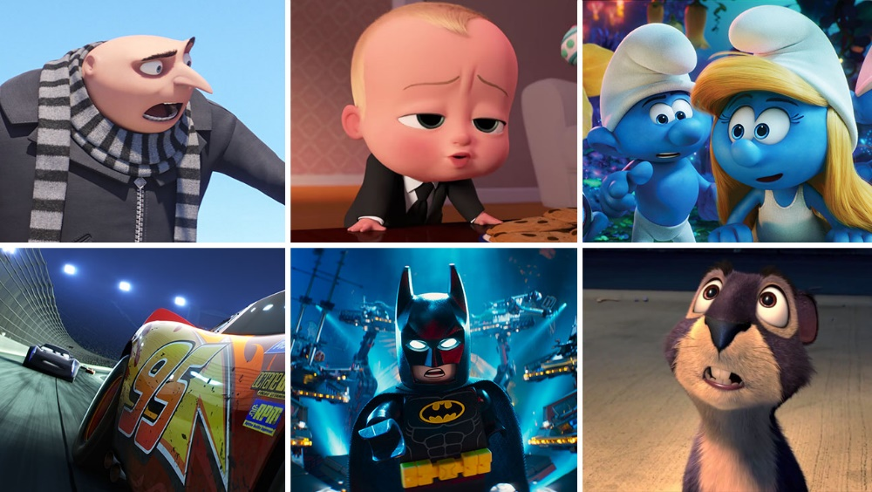

Movies/ special effects

Slide 6


Video games and Simulation
Image: Megan Murrell

Slide 7
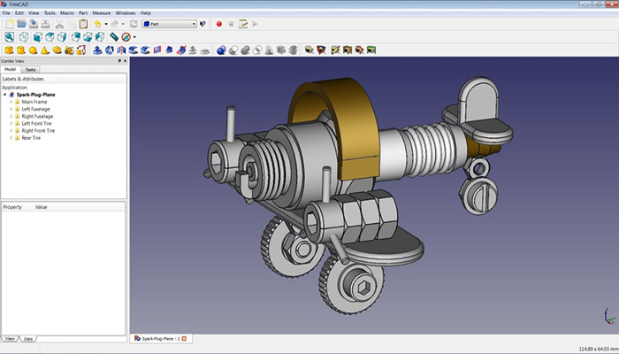
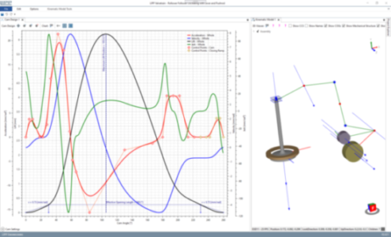
CAD-CAM & Design

Slide 8
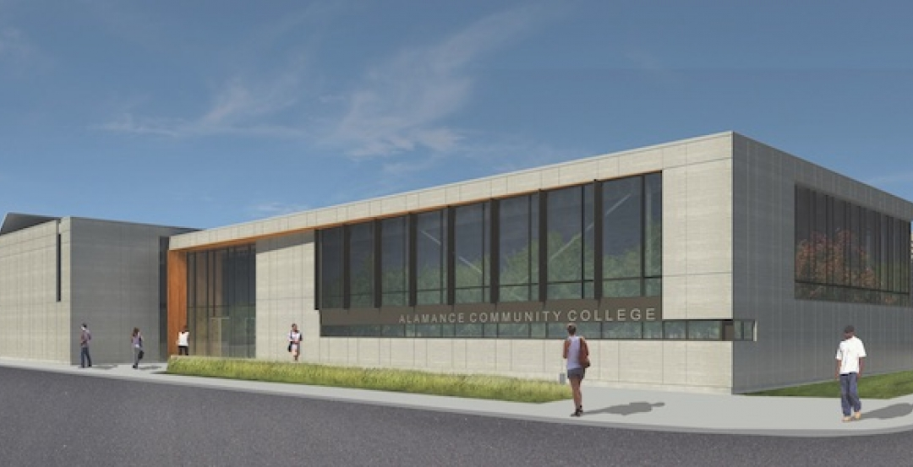
Architecture

Slide 9

Virtual reality

Slide 10
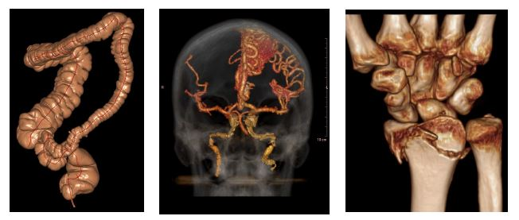
Medical imaging

Slide 11

Education

Slide 12
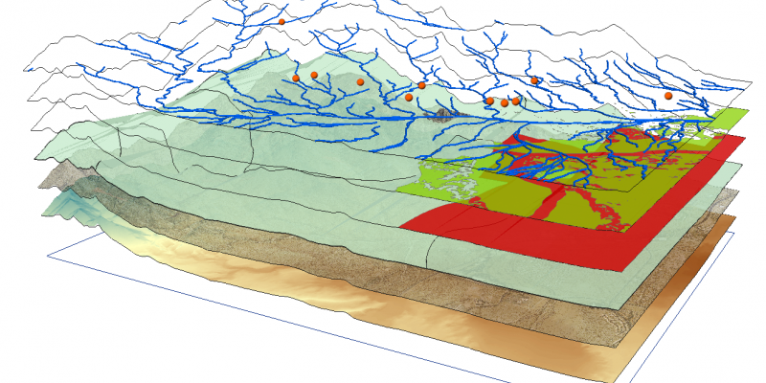

Geographic info systems & GPS

Slide 13
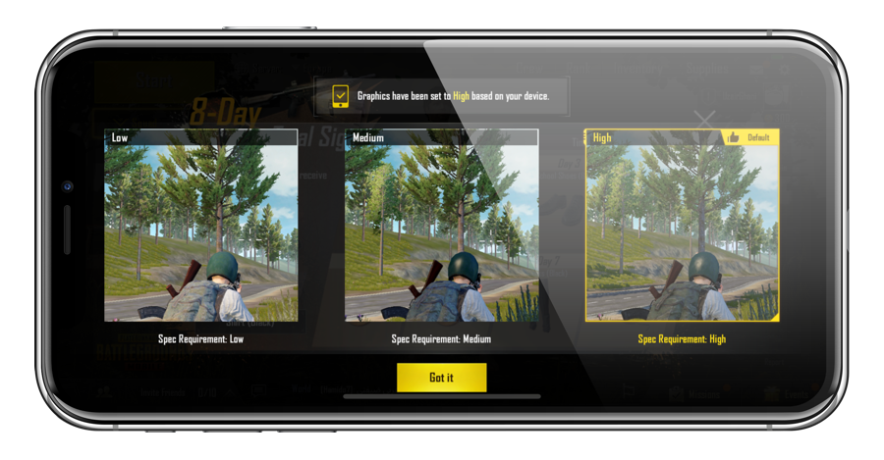
Any display

Slide 14
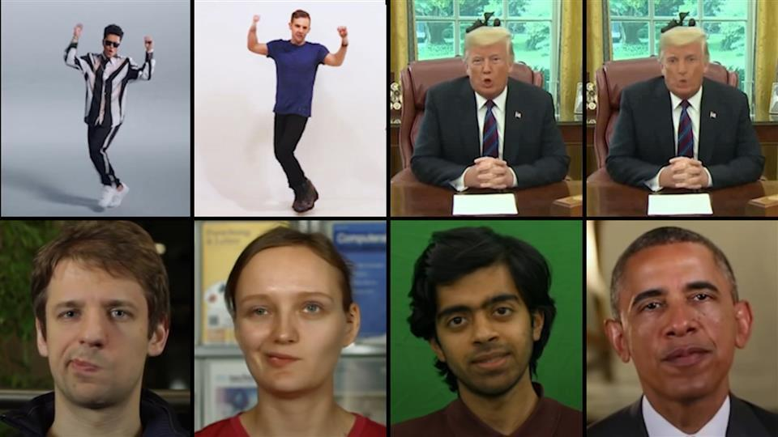
Deepfakes

